Slide 1
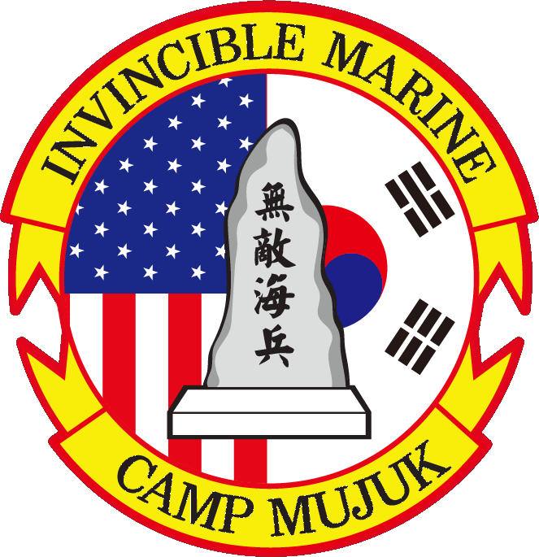
The Corps’ Western Most Fighting Position
Vision
A professional (discipline, character, standards, accountability) agile (problem solvers with solutions – not excuses), ready force (mentally and physically tough and technically proficient), prepared and able (always ready) to respond and succeed in any crisis and/or contingency.

Slide 2
The Corps’ Western Most Fighting Position
Mission
Camp Mujuk provides facilities, facilities maintenance, life support, and training coordination for visiting Marine Corps units on a continual basis in order to facilitate combined training with Republic of Korea (ROK) military units during peacetime and support to tenant units during contingency.

Slide 3
The Corps’ Western Most Fighting Position
Guiding Principles
Embrace our mission (Always in Support)
Find Ways for Yes, we Can – Not Excuses for No, we Can’t
Lead by our Own Example
Selfless – Not Selfish
Always Strive for Perfection
Take Responsibility for Everything We do or Fail to do
Seek Self-Improvement
Be a Person of Character
Treat All People with Dignity and Respect
Teach, Mentor, Train and Educate
Enforce Customs and Courtesies
Live up to the Legacy of Those who have Gone before

Slide 4
The Corps’ Western Most Fighting Position
Top Priorities
Provide World Class Support
Maintain a High State of Readiness at all Times
Educate, Train, Mentor, and Develop our Marines
Strengthen US-ROK Relations Through our Own
Efforts and Example

