Slide 1

Unit Energy Manager (UEM) Program
Training #4: Behavior Change

Slide 2
Content Outline
What is Behavior Change?
Behavior and the Energy Ethos
Audience
Behavior Change Curve
Behavior Change Theory
Promotional Materials
Discussion

Slide 3
What is Behavior Change?
Behavior change programs, encompass a broad range of activities and approaches, which focus on the individual, community, and environmental influences on specific behaviors – that once changed, will help achieve an end goal.
Examples of behavior change campaigns:
  “Only You Can Prevent Forest Fires”
  Wearing seatbelts (e.g., “Click It or Ticket”)
  Smoking cessation (e.g., “Truth” campaign)
  Exercise (e.g., “Let’s Move” campaign)
  …can you think of any more? USMC examples?
Notes:
Explain the examples:
Smokey the Bear – the behavior was that campers were throwing cigarettes and matches while in the forest, and not putting campfires out. This campaign encouraged people to stop and think about how their behaviors can affect the environment and their safety.
Seatbelts –a combination of policies, law enforcement, and public services announcements made wearing seatbelts the new normal.
Smoking cessation – there have been many different efforts to get people to stop smoking. Think about the “Truth” campaign commercials that the audience want to rebel against the tobacco industry.
Exercise – the First Lady is trying to change behavior in children to prevent childhood obesity by getting them to do physical activity for 1 hour per day.
Ask UEMs if they can think of other examples, especially ones in the Marine Corps. For example, Field Days/barracks inspections encourage Marines to be more tidy in their living spaces. Ask UEMs what was used to change the behavior (leadership communications, etc.).

Slide 4
Behavior and the Energy Ethos
The focus of our behavior change effort is the Energy Ethos – the shared vision that the efficient use of energy resources is a critical component of mission readiness. UEMs will promote the adoption of the Energy Ethos in their unit.
Some specific behaviors the Energy Ethos calls for:
  Use less energy and water at work and at home (Turn off lights; use less heat/AC; use less water)
  Make a habit of reporting energy or water waste (Water leaks; windows open with AC on)
  Come up with innovative ideas for conservation

Slide 5
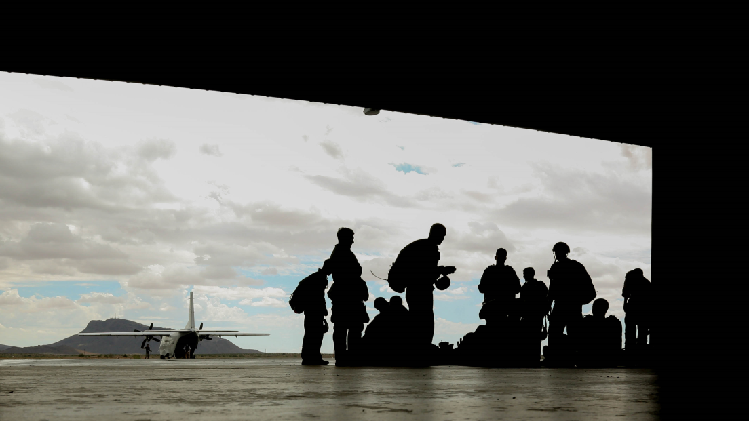
Discussion: Audience
Knowing your audience is vital to behavior change.
Marines are one of the target audiences of the Energy Ethos.
You are a Marine – what are some characteristics and motivations of Marines?
Notes:
Note that the campaign will target Civilian Marines and Marine Families as well, but that UEMs’ current primary focus is on Marines in their unit.
This should be a discussion - write down what they say, if possible.
Some characteristics and motivations:
Young
Very busy with training, PT, work
Answer to strict leadership chains
Enjoy competition

Slide 6
Behavior Change Curve
Audiences all start at different points in the behavior change curve. The ultimate goal is to achieve a state of Ownership with all target audiences.
Ownership
Level of Support
Adoption
Acceptance
Understanding
Awareness
Time
Notes:
Briefly explain the steps of the Change Curve – the following slides will go more in depth.
Ownership is the goal for all Marines, but in particular for UEMs.
Stage matching communications will help advance Marines along the behavior change curve.

Slide 7
Behavior Change Curve
During the Awareness stage, Marines move from not knowing about energy to becoming aware that the UEM Program and Energy Ethos exist, and that energy is a priority.
A Marine may become Aware of the Energy Ethos by:
Hearing leadership talk about energy
Noticing energy mentioned on news or social media
Seeing posters and flyers about energy
To move Marines to the next stage, UEMs should:
Encourage Marines to read all communications
Actively answer questions from the unit
Ask unit leadership to support efforts
Post Marine Corps Energy posters
Ownership
Adoption
Acceptance
Understanding
Awareness
Time

Slide 8
Behavior Change Curve
During the Understanding stage, Marines learn the purpose of the UEM Program and Energy Ethos, and understand that they are being asked to reduce energy consumption.
A Marine may Understand the Energy Ethos by:
Reading memos, emails, or news stories about energy
Asking peers, leaders, or UEMs to explain energy efforts
Thinking about how energy applies to daily work and life
To move to the next stage, UEMs may:
Explain how the Ethos benefits the mission and Corps
Ask leaders to develop accountability measures
Share 5-Ways to Save materials
Ownership
Adoption
Acceptance
Understanding
Awareness
Time

Slide 9
Behavior Change Curve
During the Acceptance stage, Marines accept that the Energy Ethos is the new normal, and that they need to try to reduce energy use.
A Marine may Accept the Energy Ethos by:
Beginning to reduce energy use and seeing that it is simple
Realizing that other Marines and leaders are doing it too
Participating in energy competitions or initiatives
To move to the next stage, UEMs may:
Share success stories and data about unit efforts
Recognize individual Marines who have been helpful
Emphasize how much sustained action can save
Post point-of-interaction materials
Hold competitions and activities
Ownership
Adoption
Acceptance
Understanding
Awareness
Time

Slide 10
Behavior Change Curve
During the Adoption stage, Marines will voluntarily take steps to reduce energy use, will operate by the Energy Ethos, and will acknowledge and work with their UEM.
A Marine may Adopt the Energy Ethos by:
Developing lasting energy efficient habits
Printing out flyers and tip sheets for use at work or home
Coming up with innovative ideas to save energy
To move to the next stage, UEMs may:
Ask leadership to recognize helpful Marines or
consider energy use in reviews and reports
Give more opportunities to lead and compete
Ownership
Adoption
Acceptance
Understanding
Awareness
Time

Slide 11
Behavior Change Curve
During the Ownership stage, Marines will have adopted lasting efficient habits, and will act as a champion for the Energy Ethos for their peers.
A Marine may take Ownership of the Energy Ethos by:
Taking an active role in assisting a UEM with their efforts
Advocating energy saving behaviors to other Marines
Offering to help implement innovative energy ideas
UEMs should all achieve a state of Ownership
of the Energy Ethos. Many Marines won’t reach
this point, but the ones who do reach
Adoption or Ownership will be important
assets for a unit, helping to acclimate
new Marines to the unit’s
energy standards.
Ownership
Adoption
Acceptance
Understanding
Awareness
Time

Slide 12
Behavior Change Theory
The Diffusion of Innovations Theory explains how Marines will adopt change at different rates. Some will try it immediately, while others may resist for a long time – don’t be discouraged if not all participate immediately!
As time progresses →
Notes:
Example: Smart phones. Some people go out and buy the newest models as soon as they go on sale. There are others that hold out a bit longer – and then there are those who still stick with their land lines.
Categories:
- Innovators (first to adopt)
- Early Adopters
- Early Majority
- Late Adopters
- Laggards

Slide 13
Behavior Change Theory
The best way to successfully change behaviors is to make the change “Easy, Fun, and Popular.”
Easy | Fun | Popular
Provide Marines with precise instructions Emphasize how simple these changes are | Incorporate competition Encourage Marines to work together | Get Marines talking about it Ask leadership to make it a unit priority

Slide 14
Behavior Change Theory
Individuals will change if they:
Believe the new behaviors are important
Think their actions will make a difference
Have seen others do it
Think it is the norm in their group
Know how to do it and believe that they can
See that their actions are having an impact

Slide 15
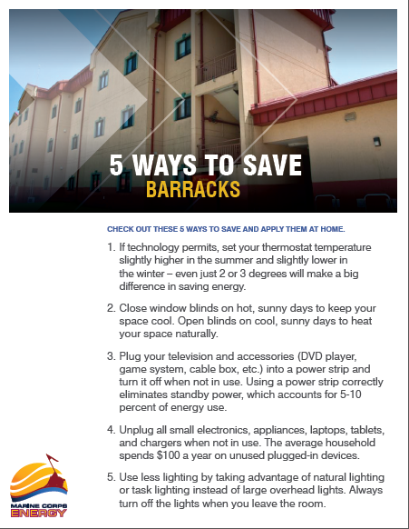
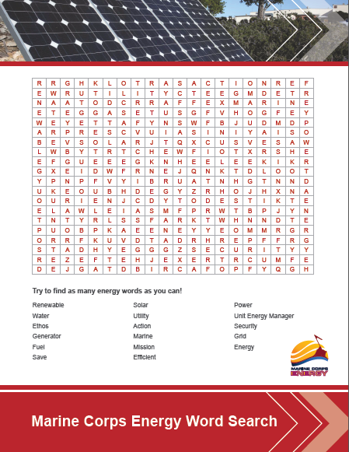
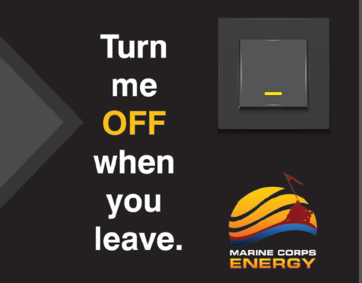
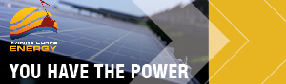
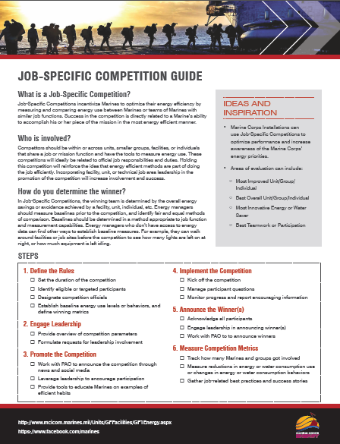
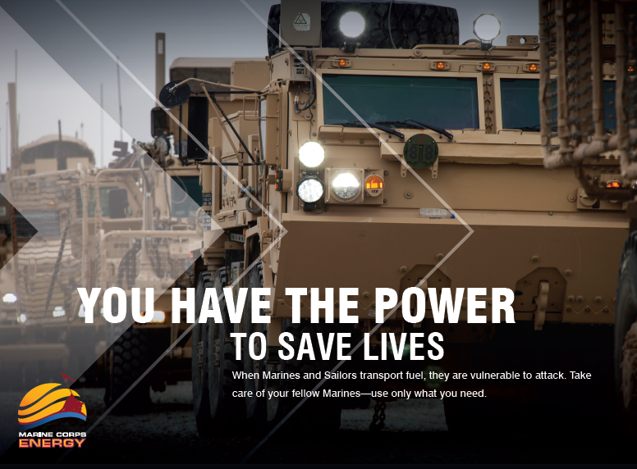
Materials for Change
Over 40 communications pieces were developed to support Marine Corps Energy behavior change efforts.
Notes:
Make sure Marines are looking at the hard copies of the materials during this part of the presentation.
We mentioned a lot of this back when we went through the Change Curve.
The materials, as outlined here, correspond to the behavior change curve.
In the beginning, for Awareness and Understanding, we have Posters, Leadership Messages, and Events.
As we progress toward Acceptance and Adoption, we bring in more social media and news messages to explain the effort, and provide flyers and tip sheets so Marines know exactly what to do.
As we move toward Ownership, competitions are emphasized to make this effort more fun and engage Marines in the effort.
Awareness & Understanding resources:
Marine Corps Energy Posters (4)
Energy Ethos Facts and Talking Points
Installation Memo Template
Speech Template
EAM Event Toolkit
5 Things to Know blog post
Social Media messages
Word Search
Crossword Puzzle
Acceptance, Adoption & Ownership:
Tip-a-Day Calendar
5 Ways to Save Flyers (8)
Competition Guides
Point of Interaction Materials

Slide 16
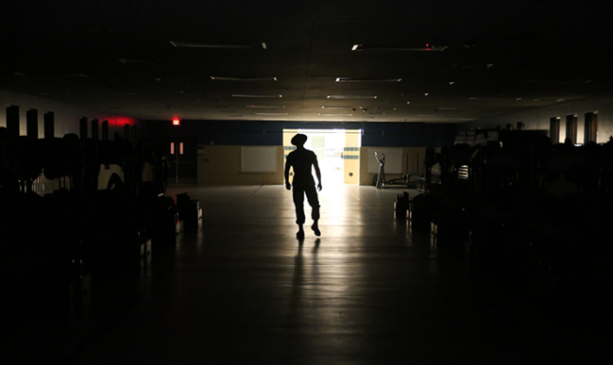
Discussion: Challenges
Think of the challenges you will have in getting Marines in your unit to make changes to their energy behavior. What are some that you predict?
Notes:
Ask UEMs to think about the issues. What challenges will there be in getting Marines to give up long showers, turn out their lights, unplug appliances, or not let vehicles idle? They can think about it from a personal perspective.

Slide 17
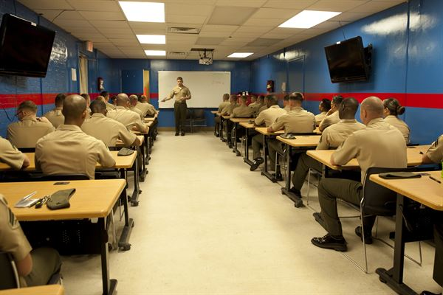
Discussion: Motivations
We just discussed the challenges. Now, what are some things that may motivate Marines to change their behavior?
Notes:
Now that we’ve discussed the challenges, what are some motivating factors? The UEMs may talk about competition, rewards, accountability, etc.

