Slide 1
VWAP Quarterly Council Meeting Q3: 2013
Regional Victim and Witness Liaison Office:
First Lieutenant Kevin Towler
Captain John Aaron
kevin.towler@usmc.mil
john.aaron@usmc.mil
(315)645-4303/4263
New VWAP Website: http://www.mcipac.marines.mil/mcipac/CampButler/VWAP.aspx

Slide 2
Agenda:
1. Unlearn the old
2. Learn the new
3. Questions/Feedback
*If you have not yet been trained, star your name on sign-in sheet. This meeting will serve as your training.*

Slide 3
Revisions to VWAC Protocol:
Most of the time, you can and should fulfill your duty without ever contacting:
Victim
UVA/VA
SARC
You are (primarily) NOT a service provider → Data Tracker for Command
Your job is to ENSURE that VWAP services have been provided by those who are required to provide them and DOCUMENT that they have been provided

Slide 4
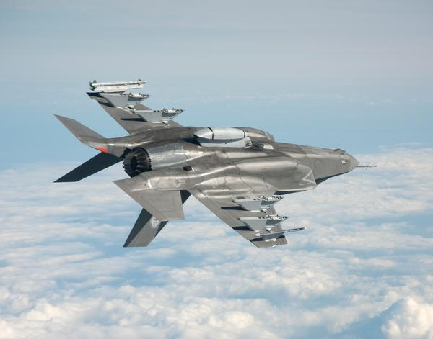
High-Speed, Low-Drag PULSE 7-13
Drastically reduced amount of information you are required to record
Your S-1/G-1 should be a one-stop shop

Slide 5
Victim and Witness Assistance Coordinator Training Update

Slide 6
Who is a Victim?
Victims
Military members
Military dependents
If under 18, incompetent, incapacitated, or deceased, then the:
A. Spouse, guardian, parent, child, sibling, family member, or another person designated by court
i. Note this on the PULSE Checklist

Slide 7
Types of Crimes Requiring VWAC Action
VWAP applies to a victim of any crime.
Most Common Examples:
Assault
Sexual Assault/Misconduct
Theft
Communicating a Threat
Hazing

Slide 8
Witnesses
BLUF: VWACs will rarely track on witnesses
Highly Significant Witnesses
Witness protection is required
Witness is being ordered to testify
VWLO will inform you if/when you need to track on a witness

Slide 9
VWAP Process
VWAC Takes Action:
PULSE CHECKLIST
UNRESTRICTED
“Restricted/Unrestricted” in SAPR vocabulary is not the same as “Restricted” WRT a blotter entry

Slide 10
Your Friend: The PULSE Checklist (Rev 7-13)
Interactive Form that ensures you have fulfilled your duty as required under MCO 5800.14
All required information can be obtained from your S-1/G-1

Slide 11
After S-1/G-1:
PMO
(315)645-3885
Military Justice
(315)645-3982
See Contact info on DD 2701
**SAPR personnel will not answer your questions**

Slide 12
DD Form 2701
CID/PMO/NCIS are required to issue the DD 2701
ONLY if you cannot confirm it has been issued, issue one yourself
Contents:
Explains victim rights
Provides contact information for relevant service providers
NCIS/CID/PMO, Military Justice, Legal Assistance
Forms are available on the VWAP website
Fill in your number in appropriate block before distributing

Slide 13
Victim/Witness Handoff
When your CO decides to move a victim or witness to another unit, he or she must immediately notify you, so that you can contact the other unit’s VWAC, and scan and email the checklist you have so far on that victim or witness.
THIS IS NOT A SUGGESTION. We cannot allow victims to fall through the cracks and jeopardize their safety.

Slide 14
Pre-Trial Confinement
Victims must be notified of changes in the pre-trial confinement status of the accused
Each time you fill out a PULSE → verify whether there has been any change and whether the victim has been notified
If not, notify the victim

Slide 15
Transitional Compensation
I. Forms of Compensation
Monetary payment
Medical/Dental
Commissary and Exchange privileges
II. Eligibility
Marine abuser must have been on active duty for > 30 days
Marine abuser must have been 1) separated for a dependent-abuse offense pursuant to a court-martial or 2) administrative separation; or, 3) at court-martial, sentenced to total forfeiture of all pay and allowances (in which there is no separation/discharge); and
Marine abuser must have committed at least one dependent-abuse related offense

Slide 16
Transitional Compensation: Who is Ineligible?
I. When would Transitional Compensation Fund benefits stop or never be processed?
Dependent spouse remarries
Dependent spouse cohabitates with abusive Marine spouse
A competent authority determines that the 1) spouse was an active participant in child abuse and the 2) abused dependent child resides with the co-actor spouse
A. Spouses who abuse each other may still be eligible for compensation

Slide 17
DD Forms 2702-2704
Relate to milestones in the trial process
TC assignment, Preferral, Art 32, Referral, Arraignment, Motions, Case-in-Chief
Case Management System Legend
Responsibility of Trial Counsel to distribute
Your Responsibility:
Ensure form has been distributed and document this in PULSE checklist

Slide 18
Weekly CMS Update
Read through the update and look to see if there are cases pending from your unit
Track any changes
CMS update + Date prompts on PULSE itself will inform you when you need to fill out the next PULSE checklist
CMS Legend available on VWAP website

Slide 19
No Privileged Communications
You are a direct representative of the command
Whenever you speak with a victim/witness, inform him/her not to say anything to you that he/she would not say to the CO

Slide 20
VWAP Website
VWAP related materials needed for your VWAC binder:
MCO 5800.14, Quarterly statistics log, Annual training log, Training Slides
General and Local VWAP resources (DD 2701’s)
If you need a document/file, check the website:
URL: http://www.mcipac.marines.mil/mcipac/CampButler/VWAP.aspx
Google: Camp Butler → Click on MCIPAC (first option) → Click on Victim Witness Assistance Prog → Command Resources

Slide 21
VWAC vs UVA
VWAC = primarily a record keeper
Serves as POC for victim/witness if he/she has an issue to take up with the command
Ex. Victim/Witness is placed on legal hold against his/her will
Ex. Victim would like to be connected with counseling services
Ex. Problems establishing/enforcing/re-newing MPO’s
No Privileged Communications → You represent the CO
UVA = primarily about connecting victims to services and programs
Privileged Communications

Slide 22
VWAC Binder: Your Log Book
Contents (maintain):
VWAP Roster (this is constantly updated, so replace old ones as we send you new ones)
LSSS Roster
Your Letter of Appointment signed by CO
MCO 5800.14
VWAC Training Certificate
DD 2701s (pre-filled with correct information on back of pamphlet)

Slide 23
Action Items:
Ensure your VWAC Binders are 100% and up to date
Pay attention to CMS weekly update; Keep up w/ PULSE; mark your calendars
Ensure you train your unit (annual requirement)
→ Unit Training slides posted on the VWAP website
VWAP WEBSITE:
http://www.mcipac.marines.mil/mcipac/CampButler/VWAP.aspx

Slide 24
Questions?
VWAP WEBSITE:
http://www.mcipac.marines.mil/mcipac/CampButler/VWAP.aspx

