Slide 1
REPUBLIC OF KOREA (ROK) INTRO BRIEF
Overall Classification of Presentation: UNCLASSIFIED
UNCLASSIFIED

Slide 2
AGENDA
Background/Welcome to Korea
Unique Laws and Liberty Considerations
Operating Vehicles
Lessons learned from others mistakes
Korean Customs and Courtesies
Navigating in Korea
Travel Tips
Communication
Important Numbers
UNCLASSIFIED

Slide 3
WELCOME TO KOREA
South Korea continues to stand as one of the U.S.’s most important and strategic economic partners in Asia.
Alliance goes back over seven decades with more than 28,000 troops based in Korea.
Tensions on the Peninsula have increased since 2021, so our presence is more important than ever.
While presence is necessary from a strategic standpoint, an increase in crime and misconduct has made American bases the target of numerous protests and demands from local population that we leave or put more restrictions on troops.
UNCLASSIFIED

Slide 4
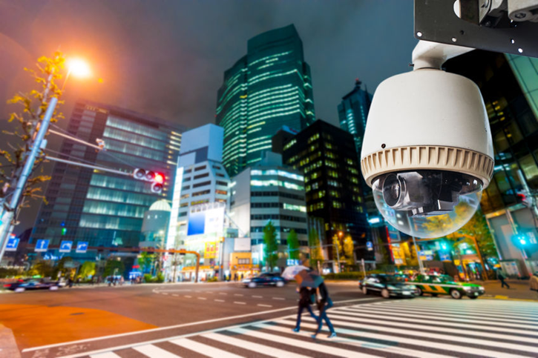
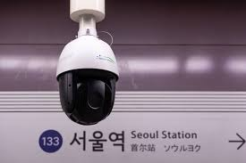
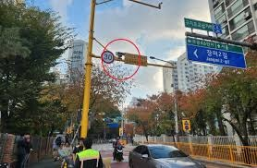
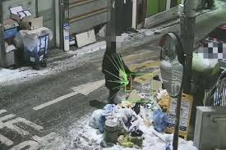
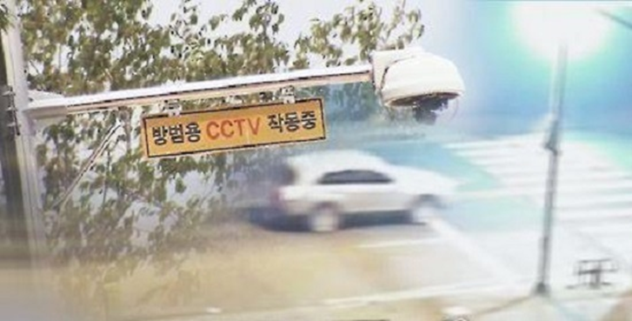
WELCOME TO KOREA
Rarely will any misconduct or crime committed on the Peninsula go undetected.
CCTV is everywhere.
UNCLASSIFIED

Slide 5
UNIQUE LAWS/CONSIDERATIONS
DRINKING AND DUI
Drinking age for U.S. Service Members is 21 per USFK Regulation 27-5
Korean legal drinking age is 19, which means if you are under 21 you will get served twice… once at the bar, then again with preferred charges under the UCMJ. Don’t do it.
The legal limit for drinking and driving in Korea is .03 not .08.
.This means that you will be legally intoxicated under Korean law even if you don’t feel any effects from the drink at all.

Slide 6
UNIQUE LAWS/CONSIDERATIONS
“MASSAGE PARLORS”
There are legitimate spas/massage parlors in Korea…BUT there are also many illegitimate “massage parlors” that are thinly veiled front for prostitution and human trafficking.
YOU HAVE THE OBLIGATION TO PROACTIVELY AVOID THESE PLACES!

Slide 7
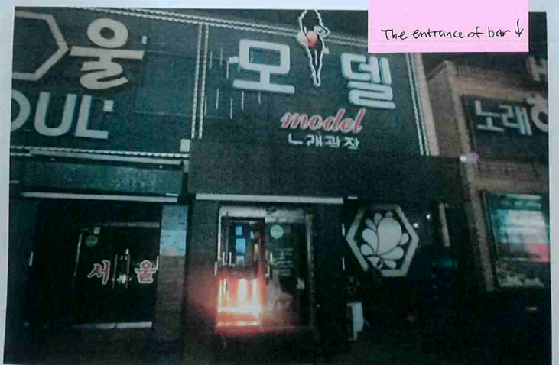
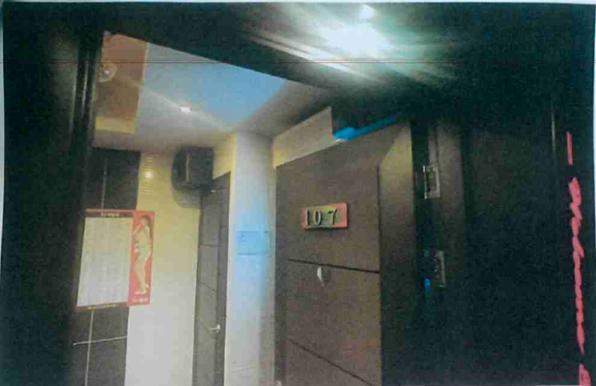
UNIQUE LAWS/CONSIDERATIONS
“MASSAGE PARLORS” CONTD.
Identifying legitimate vs. illegitimate spas:
Read reviews
Look out for pictures of a female silhouette with a heart.
The pink heart is often the unspoken sign for prostitution.
Look out for a menu or list of services and items that are shaded in pink and ₩100,000 more expensive.
Exterior signage showing heart & female silhouette on entrance
“Menu” including scantily clad female when entering private room

Slide 8
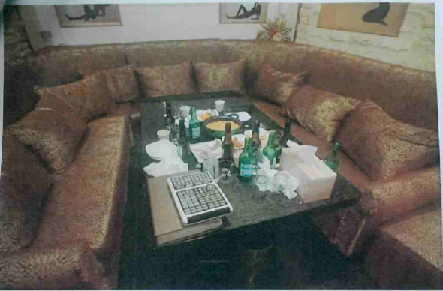
UNIQUE LAWS/CONSIDERATIONS
PROSTITUTION AND OTHER
“PAID COMPANIONSHIP” AKA JUICY GIRLS
If you engage in this type of conduct you make yourself an easy target for extortion, face criminal charges in both the ROK and U.S., face administrative punishments (loss of clearance) expose yourself to disease, and potentially support human trafficking and abuse.
DO NOT LET A STUPID, IMPULSIVE DECISION RUIN YOUR LIFE!
If entering a bar and you see Sexualized female pics…this is a sign to leave.
Notes:
The most severe form of misconduct we see in Korea involves prostitution and human trafficking. Prostitution is illegal in Korea, however it is widespread and only thinly veiled. The above picture was taken at a “karaoke bar” where women (sometimes referred to as juicy girls) join you at a table in a private room and you are charged an hourly fee. While the signage is all in Korean, the warning signs are obvious. As will be discussed in later slides, the consequences for entering places like this are severe. If you inadvertently enter a business like this, you must leave immediately.

Slide 9
UNIQUE LAWS/CONSIDERATIONS
THEFT OF PROPERTY
There is no “loser weepers, finders keepers” here in Korea.
Koreans leave often leave phones/purses unattended at bars and restaurants. It isn’t gear adrift and it certainly isn’t a gift for you to take.
If you take any property that does not belong to you, even if it appears to be dropped/abandoned, you can be charged with theft.
Quasi-robbery = theft + using force to get away. Mandatory 7 years in jail, which a judge can only reduce by half if you pay compensation. Sentences over 3 years cannot be suspended. You will do jail time if convicted.
This can include something like running away from a cab driver instead of paying for the fare.

Slide 10
UNIQUE LAWS/CONSIDERATIONS
KNIVES, WEAPONS, OR PEPPER SPRAY
Korean law is extremely restrictive when it comes to PERSONAL CARRY of weapons.
POCKET KNIVES ARE NOT AUTHORIZED regardless of blade length (because “swords” are prohibited)
The ROK defines “swords” broadly and has a catch-all provision that includes any blade “that has evident danger of being used as a lethal weapon even though the blade is shorter than 15 centimeters.”
Carry on U.S. military bases or while in the performance of official duties IS AUTHORIZED
PEPPER SPRAY IS NOT AUTHORIZED because the law also prohibits “gas sprayers.”
CONCEALED WEAPONS ARE PROHIBITED: such as knives, steel rods, hacksaw blades
Not just “weapons” but also tools/implements that could be “used to break into a house or other structure”

Slide 11
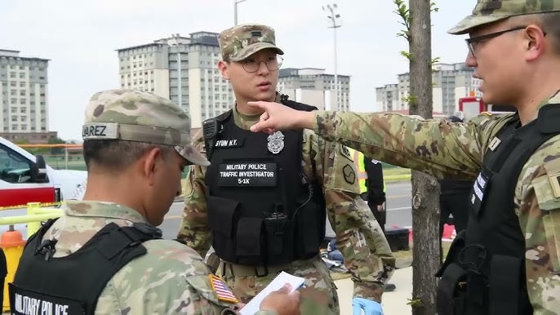
UNIQUE LAWS/CONSIDERATIONS
WHAT TO DO IF DETAINED/ARRESTED:
Identify yourself:
Do not try to hide your military affiliation when talking to ROK police. The ROK cannot honor your SOFA rights if they don’t know you’re military.
The ROK and U.S. authorities work closely together. You will not be released by ROK until they figure out who you are.
Don’t try to only provide your passport instead of CAC to ROK police. You’re only ensuring that you sit in a ROK holding cell for a few extra hours.
Don’t lie to PMO:
if they stop you while out in town; you could face possible false official statement charges and other offenses if you refuse to ID yourself to a properly identified military official.
Use common sense and OPSEC, but if they’re in uniform and/or identify themselves you should assume you’re making a statement with a duty to be truthful

Slide 12
UNIQUE LAWS/CONSIDERATIONS
WHAT HAPPENS AFTER ARREST:
You will be put on International Legal Hold while Korean authorities investigate.
You will not be allowed to leave Korea and will be involuntarily extended indefinitely.
You will likely be pulled out of your unit, they will have to continue to train without you, and you’ll be left behind when they depart Korea.
You will likely be put in a “liberty risk” status which could limit you to Camp Humphreys, order you to not drink alcohol, and require regular check-ins with your escort or a duty officer.
In some situations, your unit may be required to leave an escort behind to provide daily supervision. This is usually a SNCO, who despite doing nothing wrong will be similarly stuck in Korea on Camp Humphreys.
You are subject to Korean courts
You can be subject to substantial (usually thousands of dollars for the most basic offenses) fines and jail time if convicted.
Notes:
It doesn’t matter if you’re a reservist, scheduled to EAS/PCS, or have a pregnant wife at home. If the Korean government puts you on an international legal hold then you will be held on active duty and stuck on the Korean peninsula indefinitely.

Slide 13
OPERATING VEHICLES
RENTAL CARS VS. COMMAND LEASED VEHICLES
Rental Cars (directly assigned to an individual – like via DTS):
Requires international driver’s permit
Rental Cars (procured by command)
Drivers must complete online JKO driver’s training (USFK-US002)
Must pass JKO driving exam
Complete AK-Form 385-1-E to obtain NTV license and return to MARFORK G-4
THIS LICENSE ONLY ALLOWS THE VEHICLE TO BE OPERATED FOR OFFICIAL PURPOSES.
UNCLASSIFIED

Slide 14
OPERATING VEHICLES
VHEICLE ACCIDENTS
Driver responsibilities when involved in an accident:
Stop immediately
Moving any distance after an accident could constitute a hit-and-run
You may move the vehicle only after all of the following has occurred:
Being given consent from the other involved driver(s)
Exchanging necessary information with the other involved driver(s)
Per KNP or MP direction
Even if you are involved in a traffic accident that does not result in an injury, you are required to exchange personal and contact information with each other. Do not agree to settle with the Korean national driver. If another party is slightly injured, render first aid and/or call an ambulance.
UNCLASSIFIED

Slide 15
LESSONS LEARNED FROM OTHERS MISTAKES
Case 1: Marine possesses a vehicle. He parks it in one location, then takes a taxi to a bar. After having a few drinks, he takes the taxi back to his car and then drives his vehicle back to his lodging. After returning to his living quarters, he gets into an argument with a friend and the police are called for a disturbance. During questioning it is discovered that the Marine had alcohol prior to picking up his vehicle. He is charged with DUI. Marine was placed on legal hold and stuck in Korea for 2 years fighting the case.
Case 2: Marine goes out in town with friends during liberty. While out he begins getting hassles by a Korean National. The Korean pushes him, and he pushes the Korean back, resulting in the Korean National falling to the ground. Marine is charged with assault, put on International Hold for months, and ultimately required to pay over $2,000 USD for injuries the Korean National sustained when he pushed him back.
UNCLASSIFIED

Slide 16
LESSONS LEARNED FROM OTHERS MISTAKES
Case 3: Two Marines take a taxi but decide to ditch and dash instead of paying the fare. The taxi driver suffers a minor injury to his finger while attempting to grab the fleeing Marines. This now qualifies as quasi-theft. Marines are placed on international legal hold, are facing almost certain conviction (it’s all on camera because there are cameras everywhere), and a mandatory sentence of years in Korean prison. The Marines are stuck in Korea for several months, and ultimately pay thousands of dollars to the cab driver who mercifully tells ROK prosecutor he does not want the Marines charged. Processing for UCMJ violations follows once returned to their unit.
Case 4: At the end of an exercise while on liberty in Seoul, a Cpl who had a few too many drinks sees an unattended phone sitting on a table at a bar. Gear adrift is a gift, right? Wrong. CCTV captures the Cpl taking the phone, he is quickly identified and put on international legal hold. The unit returns to Japan, leaving the Cpl behind with a very unhappy SSgt who is assigned to remain behind as well to serve as an escort. Cpl was due to EAS, which is cancelled and he spends about 4 months in Korea before ultimately pleading guilty, paying a fine, and being returned to his unit for further processing.
UNCLASSIFIED

Slide 17
KOREAN CUSTOMS AND COURTESIES
Korean culture is generally much more conservative than American
Revealing clothes for men and women are generally frowned upon (except in Seoul)
Ex: men’s shorts should be knee length
Avoid being loud, disruptive, or unnecessarily drawing attention to yourself
Ex: you’ll notice that subways are quiet, nobody is playing music w/o headphones, people talk quietly to their friends
When asking for something, add “jooseyo” at the end which translates to “may I please have”
Sillehapnida – “excuse me, I need help”
If you say this and then try to explain what you need, people will try to help with minor things (bathroom, water, directions)
Towa Jooseyo – “please help me” if injured, in a car accident, etc. (for more emergency type stuff)
Get a copy of “DMZ to the Sea” for a detailed guide for U.S. personnel in Korea
UNCLASSIFIED

Slide 18
NAVIGATING IN KOREA
Navigation Apps:
Naver (requires a Korean phone number to register with the app)
Excellent support for use of public transportation (subway routes and bus line info) and driving directions along with walking routes, hiking trails, etc.
Can be difficult to search in English; recommend searching on Google then translate/copy/paste Hongul into Naver
KakaoMaps
Supports driving directions and public transportation directions along with walking directions
Waze (U.S. app that also works about 70% of the time in Korea, only provides driving directions)
Will often not have sufficient detail in urban areas, complex intersections, etc.
Best app for navigating around U.S. bases here in Korea.
How to use public transportation:
T-Money Card – good for taxis and all public transportation throughout Korea
Buy a card at any convenience store for a few thousand won and then load it for use like a debit card
Must use cash (won) to load the card, cannot use credit card
Most subway and bus fares are less than 1000 won
Carry Cash (won) along with a Credit Card
Any time you leave base, you should make sure you have at least some won. While credit cards are accepted almost everywhere, there are occasions when won or a Korean credit card may be required.
UNCLASSIFIED

Slide 19
TRAVEL TIPS
Taxis
In Seoul or Pyeongtaek, all taxi drivers will understand “Osan,” “Yongsan,” and “Camp Humphreys”
Having a map pulled up on your phone to show the taxi is helpful, along with having a translation from English to Korean explaining where you want to go.
Papago tends to give a more accurate translation than Google Translate
Use “Kakao T” app to call a Taxi to your pin, link a credit card to the app and it’ll charge you through the app just like Uber/Lyft
Uber also works here in Korea.
AAFES app to call taxis on Humphreys
Trains
The fastest and cheapest way to get across Korea is the train system (either standard or bullet train).
Pyeongtaek Station (20 min from Humphreys) is the closest station, is accessible by taking the 20 Bus from the Humphreys walk-in gate, or has parking if you want to drive to the station.
You can buy tickets in advance (advised on holiday weekends) or at the station.
KTX (bullet train) – requires a ticket, assigned seat, much faster, usually sells out so buy online in advance, you’ll pay based on planned departure point
KORAIL (normal train) – can use T-Money card, it’s like a subway, need to know your stop/transfer
UNCLASSIFIED

Slide 20
COMMUNICATION
Translation Apps – make sure you have a quality translation app available (Papago, Google Translate, etc.)
Korea Travel Hotline (translations, emergency assist, etc.) - https://english.visitkorea.or.kr/enu/TRV/TV_ENG_3_1.jsp
Phone calls
To dial a Korean number from an American number, you’ll need to add +82 (the Korean country code)
You need to literally type in the “+” sign along with 82 and then dial normally: +8201048675309
To dial a Humphreys DSN number from a Korean number, dial: 050-33xx-xxxx (last six digits of DSN)
Ex: MARFORK Staff Secretary DSN is (315-755-8375) so you’d dial 050-3355-8375
UNCLASSIFIED

Slide 21
CONCLUSION
Check your American cultural expectations; be prepared to be patient, calm, and forgiving.
What you may perceive as rude is probably normal (or certainly not malicious) for Koreans. Crowding into a subway, for example, and being cut off in line is part of life in a densely populated city like Seoul.
Holding the door open for the person behind you isn’t part of their expected courtesies, so don’t be surprised or offended if someone lets a door close in your face.
Korean culture does not share the American expectation of personal space; close crowding and jostling is a normal part of daily life for most Koreans and is almost never done with malice. If you get bumped without an apology, remember that from the Korean perspective there’s no apology necessary.
Nothing that happens is worth a confrontation.
Walk away. If you think you’re being treated rudely, or scammed, or otherwise abused, your job is to de-escalate. Call Humphreys PMO if you need to get police involved as they can help translate, but in general you need to be prepared to defuse and depart the scene.
You are here to represent America and help build the ROK/U.S. alliance.
All your good work will be undone with one bad incident. “One ‘oh crap’ wipes out 1,000 attaboy’s.”
UNCLASSIFIED

Slide 22
QUESTIONS?
UNCLASSIFIED

